Slide 1

Cassava Leaf Classification
Mathematical Modelling Course, Applied Computational Intelligence MSc
Babeș-Bolyai University, Cluj-Napoca, Romania

Slide 2
Team members
Teofana Enăchioiu
Alex Adăscăliței
Ligia Novăcean
MSc Student
MSc Student
MSc Student

Slide 3

Github Repository
cassava-math-ubb
The final results are contained in the same organization, on Github, in cassava-math-ubb/end-results

Slide 4
Problem statement and importance
We had to classify each cassava image into four disease categories or healthy leaf. With our help, farmers may be able to quickly identify diseased plants, potentially saving their crops before they inflict irreparable damage. Important for human nutrition, usually boiled to avoid their toxicity, being the sugar beets the runner ups. Also, they are used in laundry products, ethanol biofuel, and alcoholic beverages.
Biggest production spots
Côte d'Ivoire and Yamoussoukro
In the vicinity of Sao Paulo and Minas Gerais

Slide 5
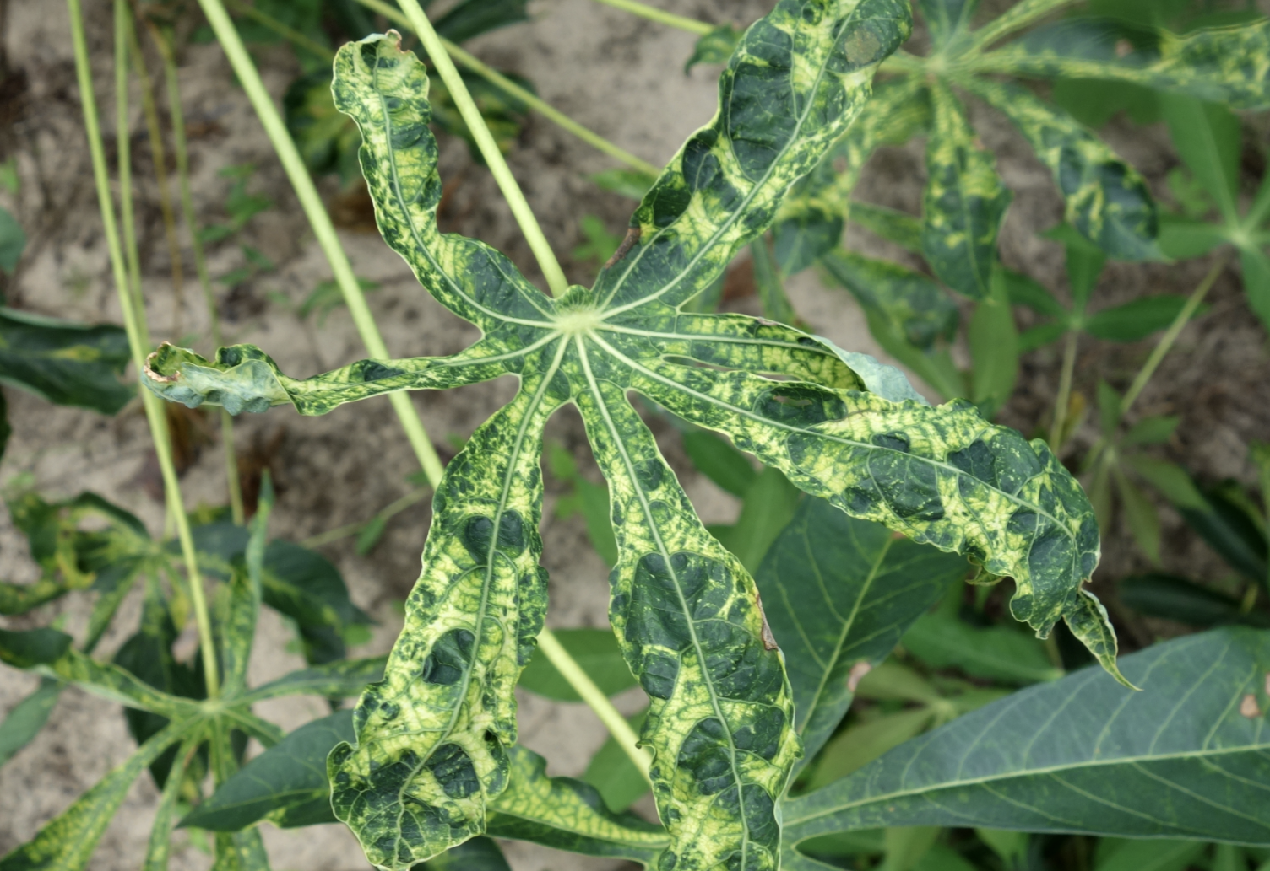
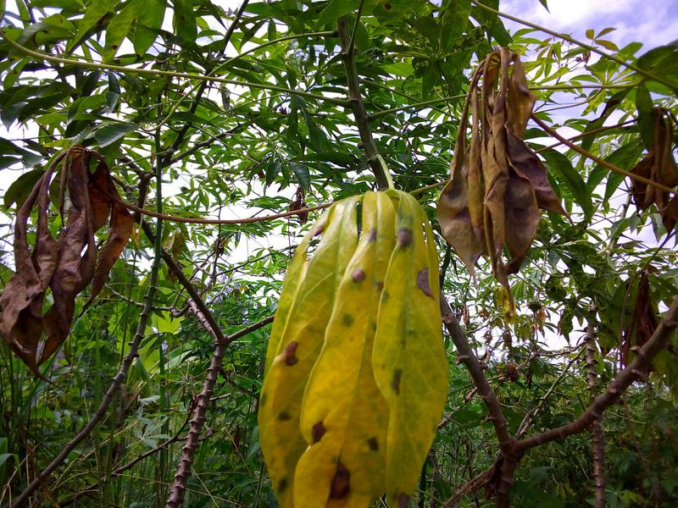
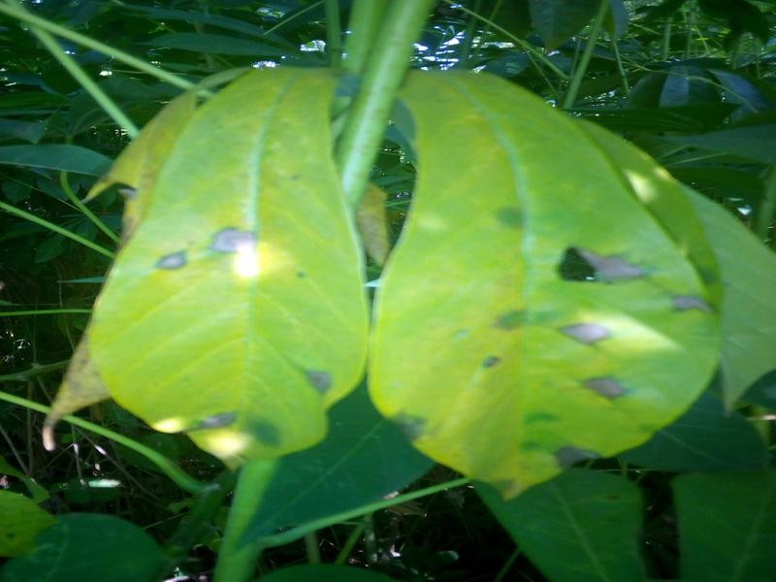
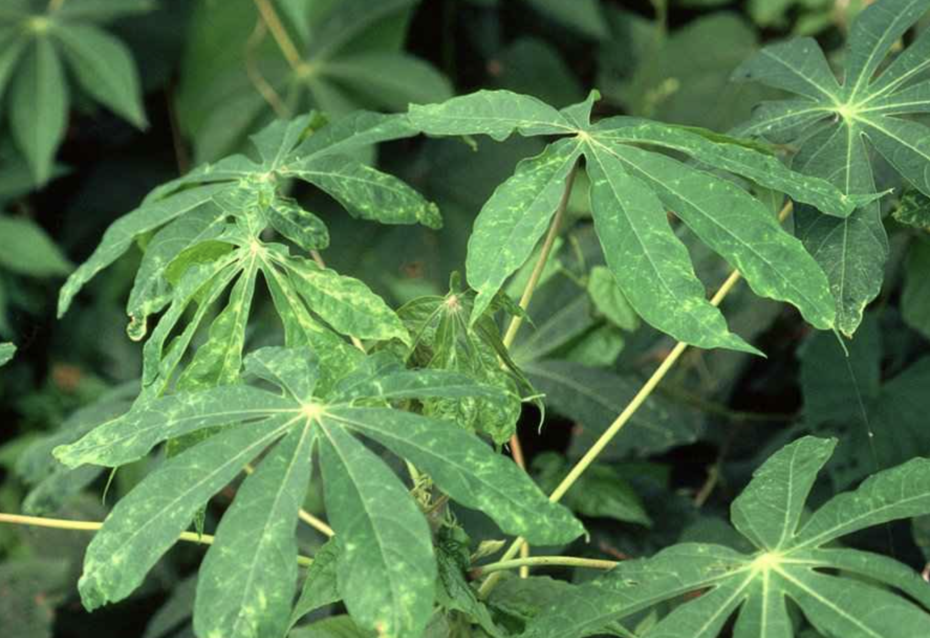
Mosaic
Green Mottle
13.158 images, a virus transmitted by whiteflies - no treatments
2.386 images, a virus transmitted by nematodes, with distinctive yellow spots, green patterns - usually they recover
Brown Streak
Bacterial Blight
2.189 images, presents necrotic vein banding and yellow patches, followed by necrosis on tubes and stems
1.087 images, water-soaked spots on the lower side of the leaves
Data labeled by the National Crops Resources Research Institute (NaCRRI) in collaboration with the AI lab at Makerere University, Kampala.

Slide 6
Public test data semantics distribution.
Although this data set contains 21397 images, it is highly imbalanced.
61.49%
60.2%
Mosaic
12.04%
14.1%
Healthy
11.15%
10.3%
Green Motle
10.23%
10.6%
Brown Streak
5.08%
4.8%
Bacterial Blight

Slide 7
Development
Found disease characteristics, ensured labels correctness, and formed a team on Kaggle and Github.
Started with ViT and Efficient Net B0, then cross-validation and optimizations
Moved training from local machines to the University’s High Performance Computing Center, and outsourced GPUs
Problem statement
Developed the initial models
Training challenges

Slide 8
Development
Made multiple submissions on Kaggle with different models, such as EffNet. B0 to B3, advancing in the ranking
Refactored the code base, documented the progress and discussed the final results.
Final results
Thoughts and discussions
Ranked 1895/3510
In top 54%

Slide 9
Approaches
Similarity Metrics
EfficientNets family
ViT
In order for us to decide whether we should approach this challenge with a classical image-processing algorithm or a deep learning model, we made use of similarity metrics in a Monte Carlo study. For this task we used the Learned Perceptual Image Patch Similarity (LPIPS), peak signal-to-noise ratio (PSNR) and structural similarity index (SSIM) similarity measurements, as they are the most used ones.
EfficientNets offer a scaling alternative to increase the width, depth, and image resolution by a compound model scaling obtained through scaling all dimensions at once. In general, this scaling improves both the accuracy and efficiency of the models by reducing parameter size and FLOPS. In using this family of models we also took advantage of the transfer learning from ImageNet.
The Vision Transformer is an image classification model relying on a Transformer-like architecture applied on sequences of image patches. On the ImageNet dataset, the 2 largest models in the ViT family obtain top 10 results. Our initial plan was to experiment with this model, but even the smaller one (Vit-B/16) required an very long training time. Having around 86M parameters, experimenting with this promising and recent architecture was not feasible given our computing resources.

Slide 10
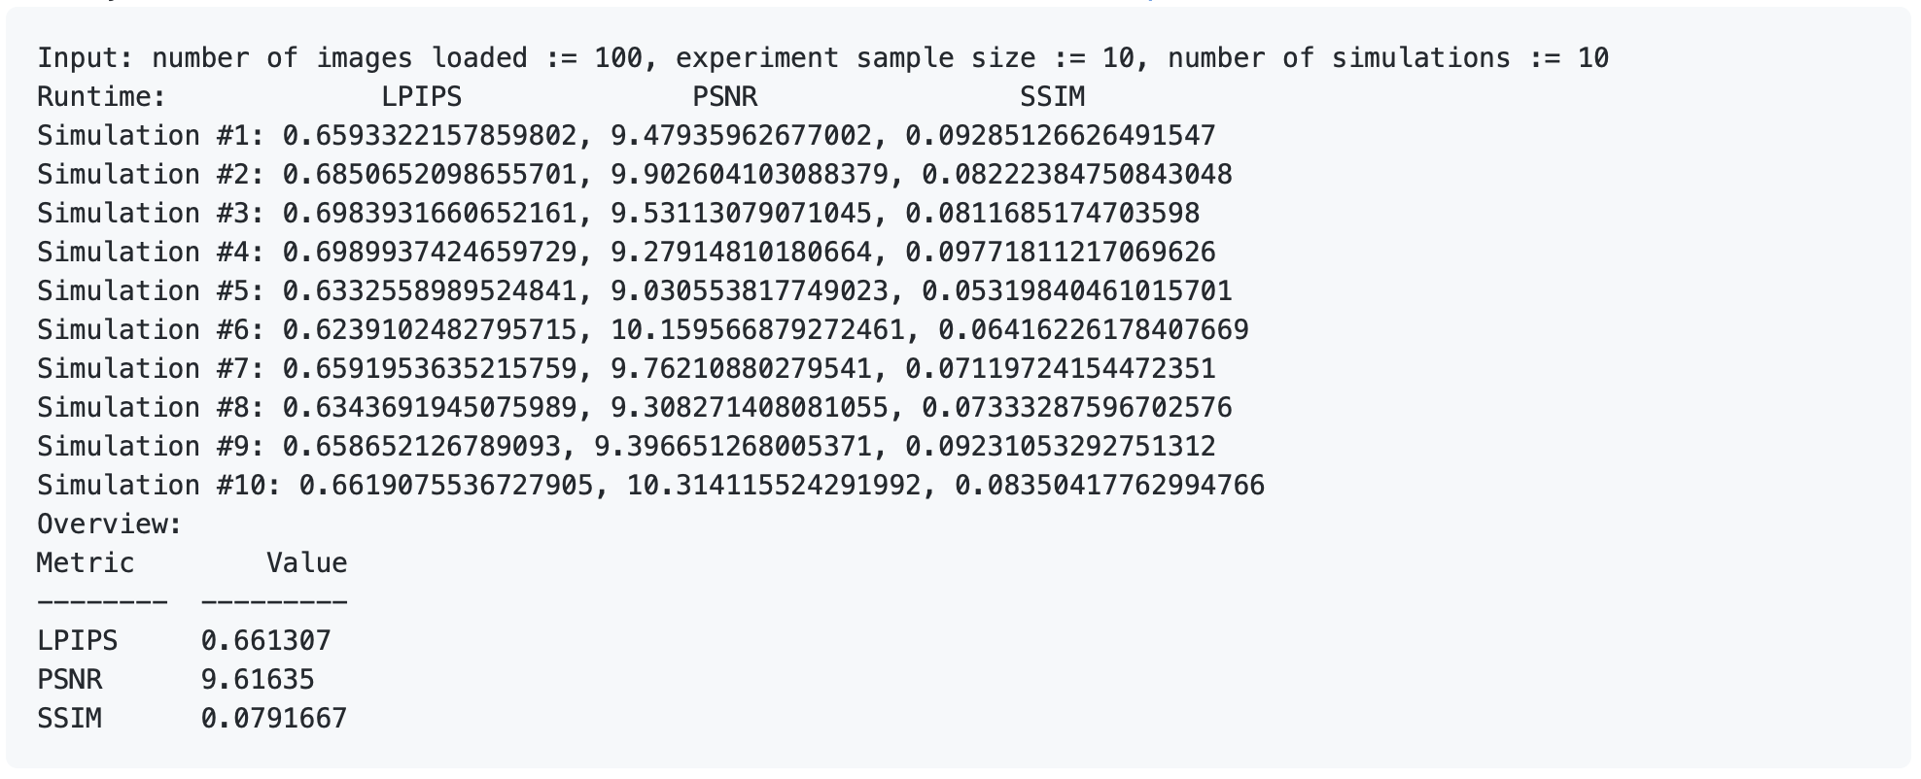
Pre-processing by means of similarity
Running the following experimental setup showed us that there is a remarkable difference between the images contained in the dataset, through metrics such as peak signal-to-noise ratio (PSNR) and structural similarity index measurement (SSIM). Given the circumstances, we decided to proceed with a recent and highly effective deep learning model instead of a classic data image processing algorithm. The Learned Perceptual Image Patch Similarity (LPIPS) metric gives more conservative feedback, but it never disagrees with our decision.
Computing such metrics requires a one-
vs-all approach, yet 21397² exceeds a
waiting time we could afford. One
solution is to run a Monte Carlo study.
The main purpose of simulations is
estimating quantities whose direct
computation is complicated, expensive,
or time consuming.
Notes:
- N set: Limit IO operations / Fit images in a
ordinary computer RAM (one vs all with all would not fit 8GB RAM)
- the T simulations governs the Monte Carlo methodology
- K images: an arbitrarily decided amount of random images for one
trail to become relevant

Slide 11
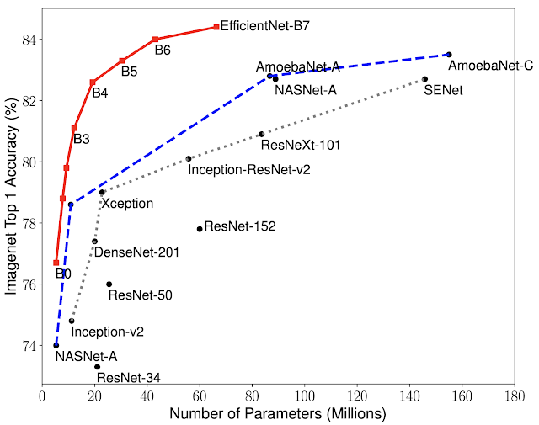
EfficientNets
One of the key issues in designing CNNs is model scaling i.e deciding how to increase the model size so as to provide better accuracy. In EfficientNets family, this problem is solved by scaling all dimensions of network width, depth, and resolution, using a global scaling factor.
These models have between 4M and 66M parameters, which is significantly less compared to other existing CNNs. The part that contributes to improving the efficiency is inherited from mobile devices networks and consists of an inverted bottleneck convolution (MBConv), which forms a shortcut connection between the beginning and end of a convolutional block.
We ran several experiments using EficientNet B0, B1, B2, and B3 and learning transfer from ImageNet and the highest accuracy we got on our dataset is 89%.

Slide 12
89.0
Top score: 91.1
Best model
Score obtained with the Efficient Net B3, 2.1% diff. up to the top submission

Slide 13
Architecture | Validation accuracy | Public test set score | Input size | Learning rate | Optimizer | Epochs | Notes | Training resources | Time
EfficientNet B3 | 0.887 | 0.89 | 512, 512 | 3.00E-04 | Adam | 40 | Test Time Augmentation: 5 steps Loss: Label Smoothing Cross-Entropy (0.2) Train augmentation: random resize and crop, horizontal flip, color jitter (Brightness, Contrast, Saturation: 0.25) Test augmentation: resize, center crop, color jitter (Brightness, Contrast, Saturation: 0.2), normalize | Nvidia GeForce RTX 2070 (8GB) | 23h
EfficientNet B3 | 0.887 | 0.89 | 512, 512 | 3.00E-04 | Adam | 40 | Loss: Label Smoothing Cross Entropy (0.2) Train augmentation: random resize and crop, horizontal flip, color jitter (Brightness, Contrast, Saturation: 0.25) Test augmentation: resize, center crop, color jitter (Brightness, Contrast, Saturation: 0.2), normalize | Nvidia GeForce RTX 2070 (8GB) | 23h
EfficientNet B2 | 0.879 | 0.871 | 512, 512 | 5.00E-04 | SGD | 17 | Loss: Label Smoothing Cross-Entropy (0.1) Train augmentation: random resize and crop, horizontal flip Test augmentation: resize, center crop, normalize | Nvidia GeForce RTX 2070 (8GB) | 10h
EfficientNet B1 | 0.889 | 0.88 | 512, 512 | 7.00E-04 | Adam | 14 | Loss: Label Smoothing Cross Entropy (0.2) Train augmentation: random resize and crop, horizontal flip, color jitter (Brightness, Contrast, Saturation: 0.25) Test augmentation: resize, center crop, color jitter (Brightness, Contrast, Saturation: 0.2), normalize | Nvidia GeForce RTX 2070 (8GB) | 9h
EfficientNet B1 | 0.881 | 0.878 | 512, 512 | 1.00E-03 | SGD | 14 | Loss: Label Smoothing Cross-Entropy (0.1) Train augmentation: random resize and crop, horizontal flip Test augmentation: resize, center crop, normalize | Nvidia GeForce RTX 2070 (8GB) | 9h
EfficientNet B1 | 0.78 | 0.757 | 240, 240 | 5.00E-03 | Adam | 12 | Loss: Label Smoothing Cross-Entropy (0.1) Train augmentation: random resize and crop, horizontal flip Test augmentation: resize, center crop, normalize | Nvidia GeForce RTX 2070 (8GB) | 8h
EfficientNet B0 | 0.8862 | 0.886 | 512, 512 | 1.00E-03 | Adam | 15 | Loss: Sparse Cross-Entropy Callbacks: EarlyStopping (monitored the value of val_loss with a patience of 5 epochs), ReduceLROnPlateau (monitored the value of val_loss with a patience of 2 epochs and a reduction factor of 0.3) Extra augmentation: rotation (45 degree), zoom (0.8, 1.2), horizontal and vertical flip, shear (0.1 degree), height and width shifting (0.1) | NVidia K80 GPU | 6h
EfficientNet B0 | 0.892 | 0.885 | 512, 512 | 1.00E-03 | Adam | 8 | K-Fold Model 3 Loss: Sparse Cross-Entropy Callbacks: EarlyStopping (monitored the value of val_loss with a patience of 5 epochs), ReduceLROnPlateau (monitored the value of val_loss with a patience of 2 epochs and a reduction factor of 0.3) Extra augmentation: rotation (45 degree), zoom (0.8, 1.2), horizontal and vertical flip, shear (0.1 degree), height and width shifting (0.1) | HPC Kotys | 40h
EfficientNet B0 | 0.875 | 0.884 | 512, 512 | 1.00E-0.3 | Adam | 8 | Loss: Sparse Cross-Entropy Callbacks: EarlyStopping (monitored the value of val_loss with a patience of 5 epochs), ReduceLROnPlateau (monitored the value of val_loss with a patience of 2 epochs and a reduction factor of 0.3) Extra augmentation: rotation (45 degree), zoom (0.8, 1.2), horizontal and vertical flip, shear (0.1 degree), height and width shifting (0.1) | HPC Kotys | 8h

Slide 14
Architecture | Validation accuracy | Public test set score | Input size | Learning rate | Optimizer | Epochs | Notes | Training resources | Time
EfficientNet B0 | 0.8862 | 0.886 | 512, 512 | 1.00E-03 | Adam | 15 | Loss: Sparse Cross-Entropy Callbacks: EarlyStopping (monitored the value of val_loss with a patience of 5 epochs), ReduceLROnPlateau (monitored the value of val_loss with a patience of 2 epochs and a reduction factor of 0.3) Extra augmentation: rotation (45 degree), zoom (0.8, 1.2), horizontal and vertical flip, shear (0.1 degree), height and width shifting (0.1) | NVidia K80 GPU | 6h
EfficientNet B3 | 0.887 | 0.89 | 512, 512 | 3.00E-04 | Adam | 40 | Test Time Augmentation: 5 steps Loss: Label Smoothing Cross-Entropy (0.2) Extra augmentation: ColorJitter (Brightness, Contrast, Saturation: 0.25) | Nvidia GeForce RTX 2070 (8GB) | 23h
EfficientNet B3 | 0.887 | 0.89 | 512, 512 | 3.00E-04 | Adam | 40 | Loss: Label Smoothing Cross Entropy (0.2) Extra augmentation: ColorJitter (Brightness, Contrast, Saturation: 0.25) | Nvidia GeForce RTX 2070 (8GB) | 23h
EfficientNet B1 | 0.889 | 0.88 | 512, 512 | 7.00E-04 | Adam | 14 | Loss: Label Smoothing Cross Entropy (0.2) Extra augmentation: ColorJitter (Brightness, Contrast, Saturation: 0.25) | Nvidia GeForce RTX 2070 (8GB) | 9h
EfficientNet B2 | 0.879 | 0.871 | 512, 512 | 5.00E-04 | SGD | 17 | Test augmentation: resize, center crop, normalize | Nvidia GeForce RTX 2070 (8GB) | 10h
EfficientNet B0 | 0.892 | 0.885 | 512, 512 | 1.00E-03 | Adam | 8 | K-Fold Model 3 Loss: Sparse Cross-Entropy Callbacks: EarlyStopping (monitored the value of val_loss with a patience of 5 epochs), ReduceLROnPlateau (monitored the value of val_loss with a patience of 2 epochs and a reduction factor of 0.3) Extra augmentation: rotation (45 degree), zoom (0.8, 1.2), horizontal and vertical flip, shear (0.1 degree), height and width shifting (0.1) | HPC Kotys | 40h
EfficientNet B1 | 0.881 | 0.878 | 512, 512 | 1.00E-03 | Adam | 14 | Test augmentation: resize, center crop, normalize | Nvidia GeForce RTX 2070 (8GB) | 9h
EfficientNet B1 | 0.869 | 0.853 | 512, 512 | 5.00E-03 | SGD | 6 | Test augmentation: resize, center crop, normalize | Nvidia GeForce RTX 2070 (8GB) | 6h
EfficientNet B1 | 0.78 | 0.757 | 240, 240 | 5.00E-03 | Adam | 12 | Test augmentation: resize, center crop, normalize | Nvidia GeForce RTX 2070 (8GB) | 8h
EfficientNet B0 | 0.875 | 0.884 | 512, 512 | 1.00E-0.3 | Adam | 8 | Loss: Sparse Cross-Entropy Callbacks: EarlyStopping (monitored the value of val_loss with a patience of 5 epochs), ReduceLROnPlateau (monitored the value of val_loss with a patience of 2 epochs and a reduction factor of 0.3) Extra augmentation: rotation (45 degree), zoom (0.8, 1.2), horizontal and vertical flip, shear (0.1 degree), height and width shifting (0.1) | HPC Kotys | 8h

Slide 15
Results
Models
Notes
Efficient Net B0 (from-the-shelf)
88.4%
trained a HPC node with 2x Intel Xeon E5-2660 v3 CPU, 10 cores per CPU, 128 GB RAM \ 10 to 40 hours \ batch size: 16, learning rate: xx, [...]
8 epochs
Efficient Net B0 (best k-fold)
88.5%
Efficient Net B2
85.3%
trained on [...] GPU \ 10 to 40 hours \ batch size: 16, learning rate: xx, [...]
timeline
Efficient Net B1
88.0%
Efficient Net B3
88.2%
Efficient Net B3
89.0%

Slide 16
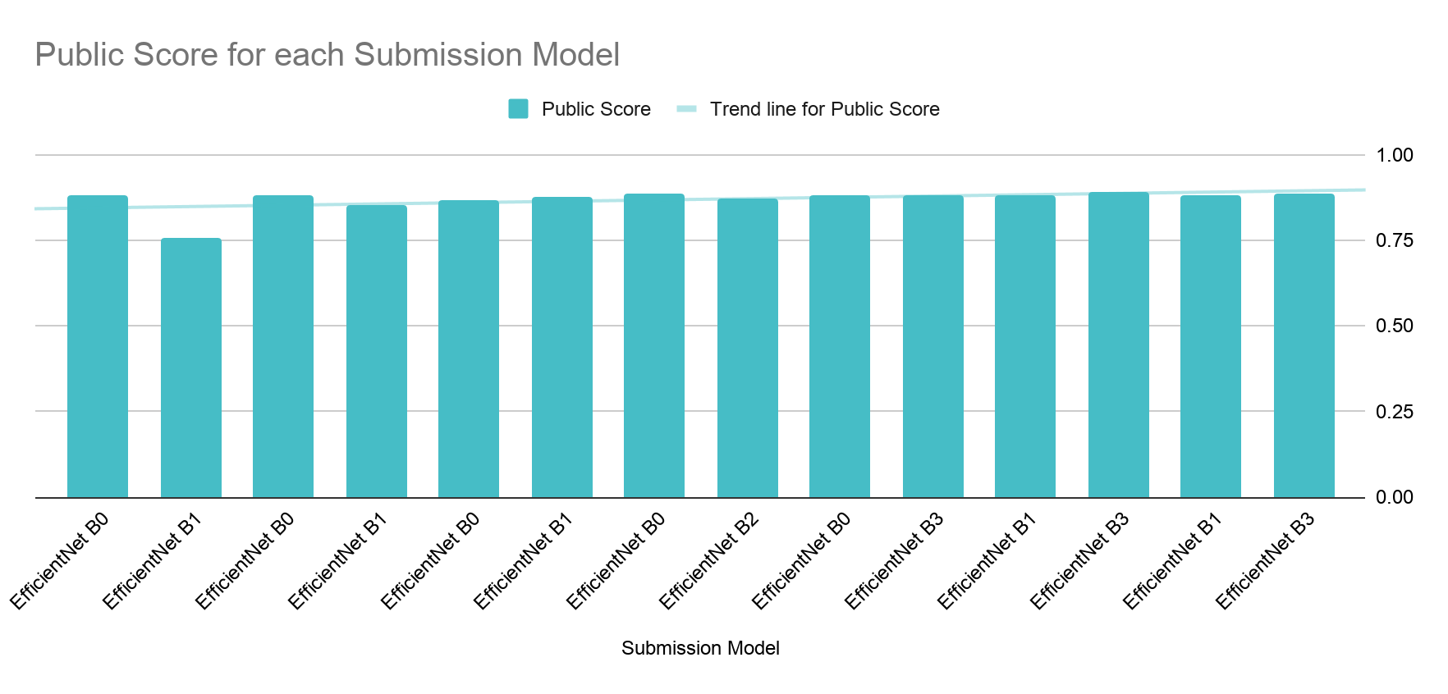

Slide 17
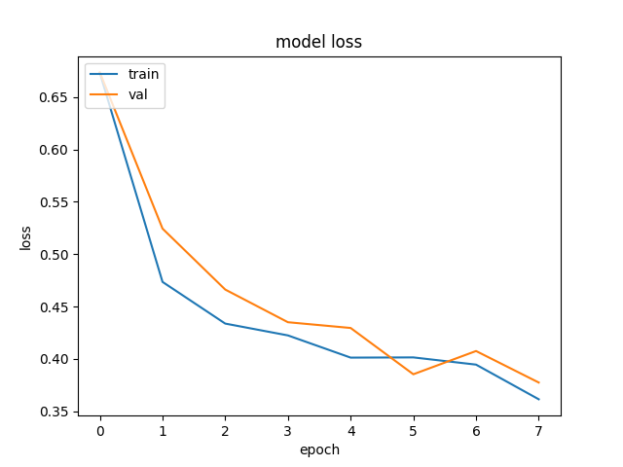
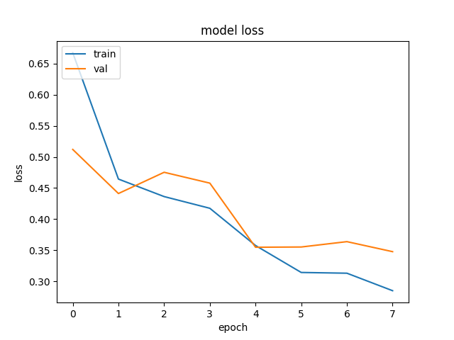
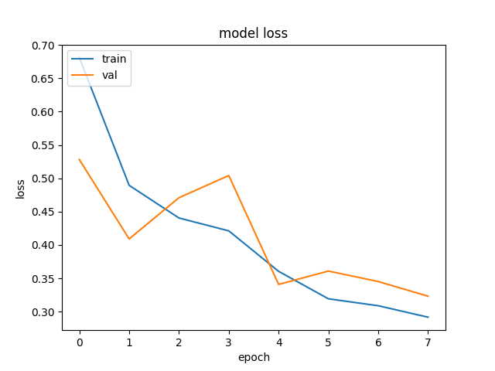
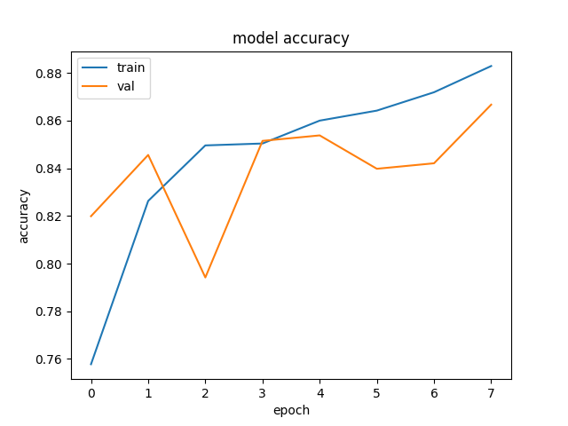
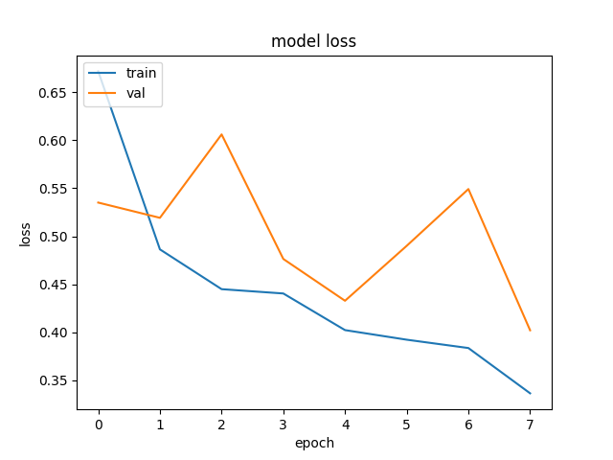
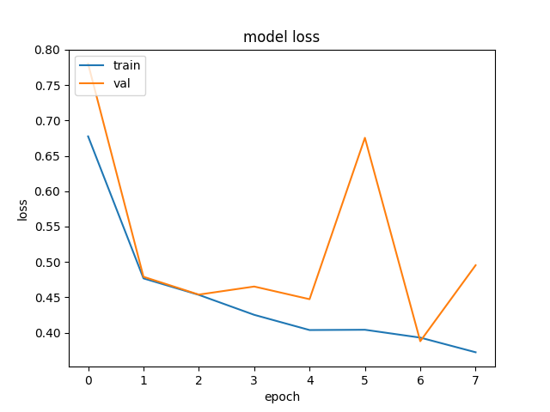
K(5)-Fold Efficient Net loss
05
04
03
02
01
For experimental purposes, we implemented k-fold cross-validation to see the behavior of the model on unknown data. We split our data into 5 batches and trained 8 epochs for every combination of 4 batches for training and one for validation. The training was made on the HPC Kotys, and took 40 hours.

Slide 18
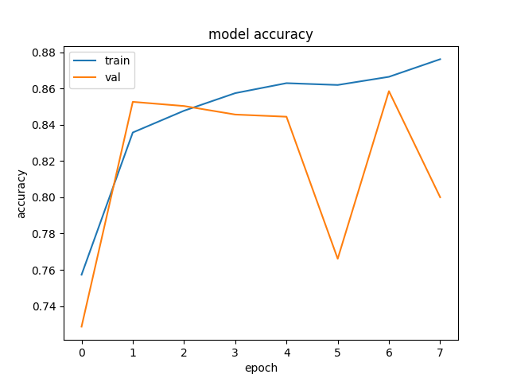
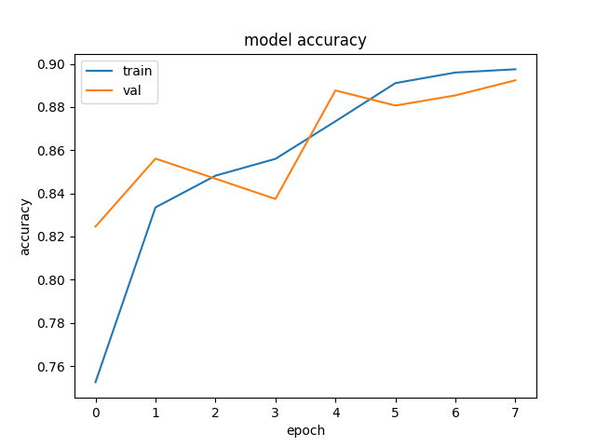
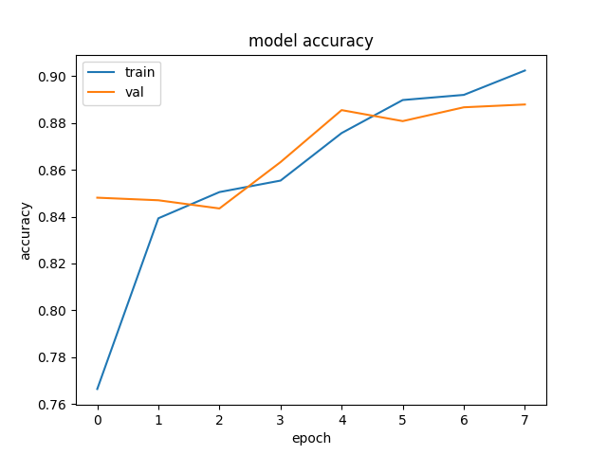
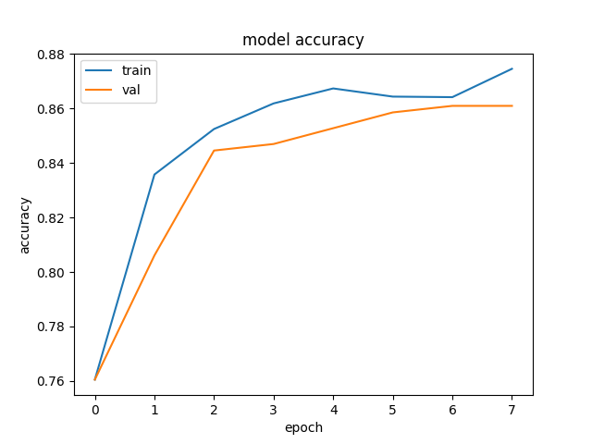
K(5)-Fold Efficient Net accuracy
05
04
03
02
01
The results after k-fold cross-validation show that the first epochs of training have spikes and higher accuracy for validation than for training. The behavior did not indicate a bad thing, but a curios effect of either dropouts or augmentation present on training and not on testing.
We computed the confidence interval on accuracy and our conclusion is that "We are 95% confident that the value of accuracy after 8 epochs is between 0.867 and 0.878".

Slide 19
K(5)-Fold Efficient Net submissions
Model 1
0.867
Model 2
0.882
Model 3
0.885
Model 4
0.868
Model 5
0.884

Slide 20
Further improvements and paths
#2
#3
#1
2x Classifier for data imbalancement
Finding better training resources
Bi-tempered loss
Given the discussions around the correctness of the data labels, we can use the bi-tempered loss. This loss uses 2 parameters called temperatures to control boundedness and tail-heaviness and, thus, compensate for both small and large margin noise.
Given the imbalance of the training set, one option is to create 2 classifiers: a binary classifier between the dominant class and all the other, followed by a classifier for all the non-dominant classes.
Transitioning from CPU to GPU on the HPC nodes, so that we may allow many more epochs to take place.

Slide 21
Thank you for your attention!

Slide 22
Additional materials.

Slide 23
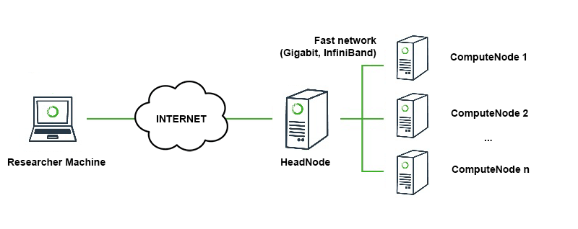
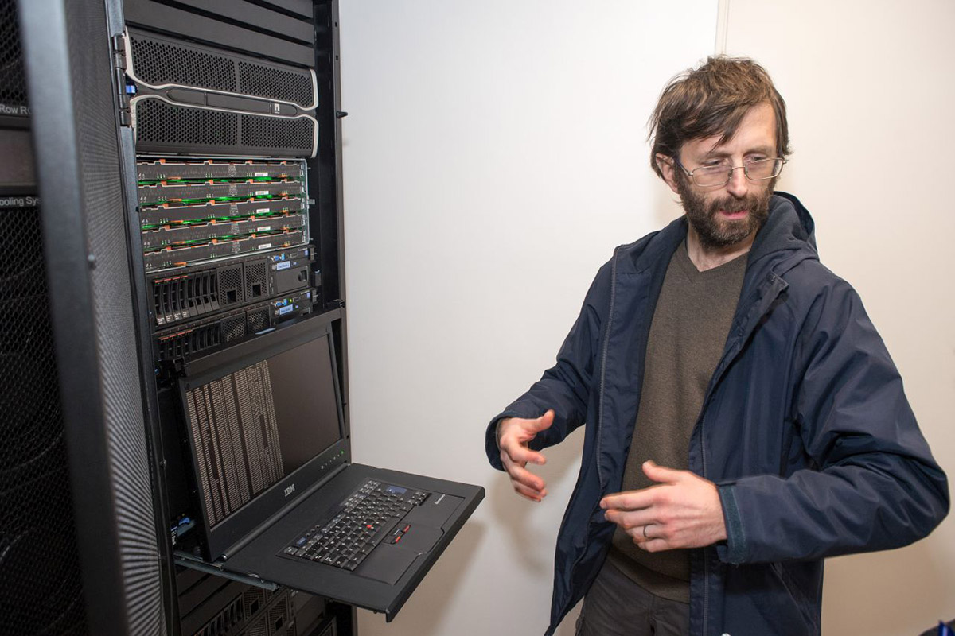
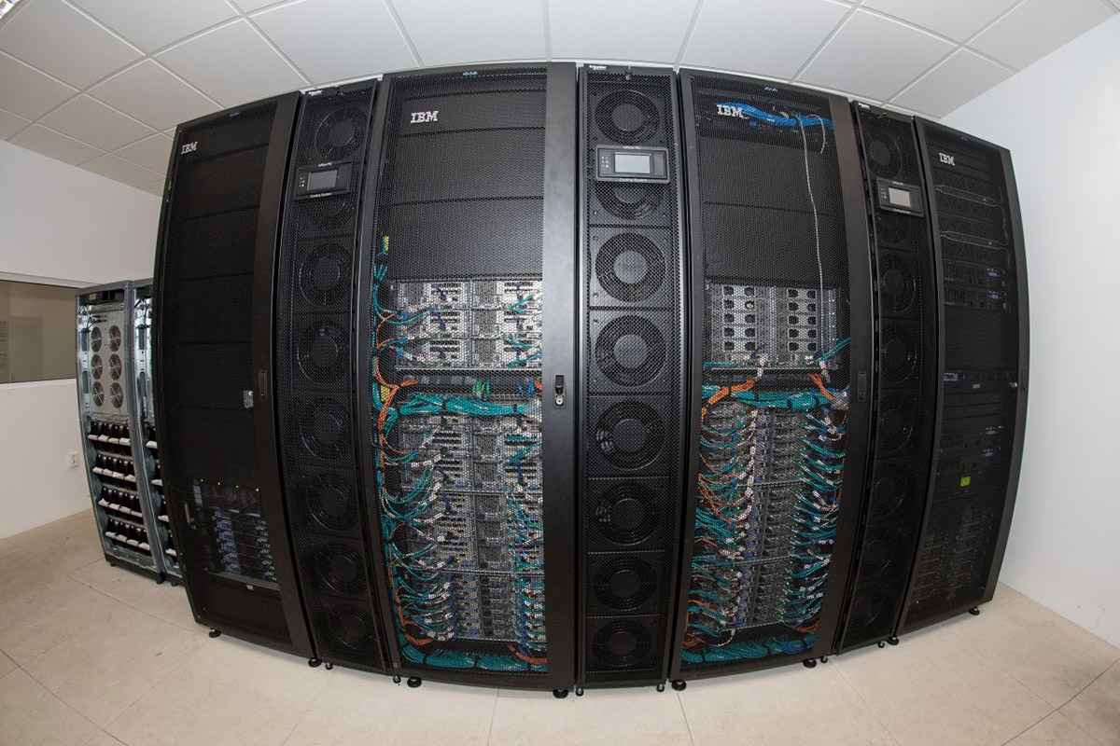

University’s resources
for machine learning
The Babeș-Bolyai University offers access to its High Performance Center, offering 68 nodes with high end 10 cores processors, K40X GPUs and dedicated Intel Phi coprocessors. In this project all actions taken on Kotys were managed manually by the team members, following the university guideline and security protocols.

Slide 24
Training on Kotys IBM Machine
Terminal 1: ssh -L local_port:kotys.cs.ubbcluj.ro:remote_port stud_credentials@www.scs.ubbcluj.ro -p stud_server_port
(running in background)
Terminal 2: sftp -oPort=local_port stud_credentials@127.0.0.1
(initiate data transfer)
data transfer
Secure file transfer to the bigdata partition
Port tunneling into the university network, then towards hpc
ssh stud_credentials@www.scs.ubbcluj.ro -p stud_server_port
[stud_credentials@linux ~]$ ssh -p hpc_port kotys.cs.ubbcluj.ro
[stud_credentials@kotys ~]$ ssh compute056
(the user must check whether any process is already running at the time they are accessing the node)
[stud_credentials@compute056 ~]$ cd /bigdata/users-data/stud_folder
(anaconda must be installed before performing the following steps)
[stud_credentials@compute056 stud_folder]$ export PATH=/anaconda3/bin:$PATH
[stud_credentials@compute056 stud_folder]$ conda create -n cassava_env --clone=/bigdata/users-data/stud_folder/anaconda3
[stud_credentials@compute056 stud_folder]$ conda activate cassava_env
(cassava_env) [stud_credentials@compute056 stud_folder]$ conda install tensorflow
(cassava_env) [stud_credentials@compute056 stud_folder]$ python efficientnet.py
CPU usage - brief setup

